Slide 1
Forecasting Future of Coffee Arabica In India Amid Climate Change
Submitted By- Shivani Bhatia (21070146011)
Submitted To- Dr. Navendu Choudhary

Slide 2

INTRODUCTION
Among the many sectors affected by climate change, agriculture is one of the most vulnerable.
The species Coffee Arabica, is particularly vulnerable to climate change, as it is highly sensitive to changes in temperature and precipitation.
Its cultivation zones are predicted to shrink significantly by 2030.
The study, published in Science Advances, found that 60% of the wild species of Arabica, the most popular cultivated coffee species is under threat of extinction.

Slide 3
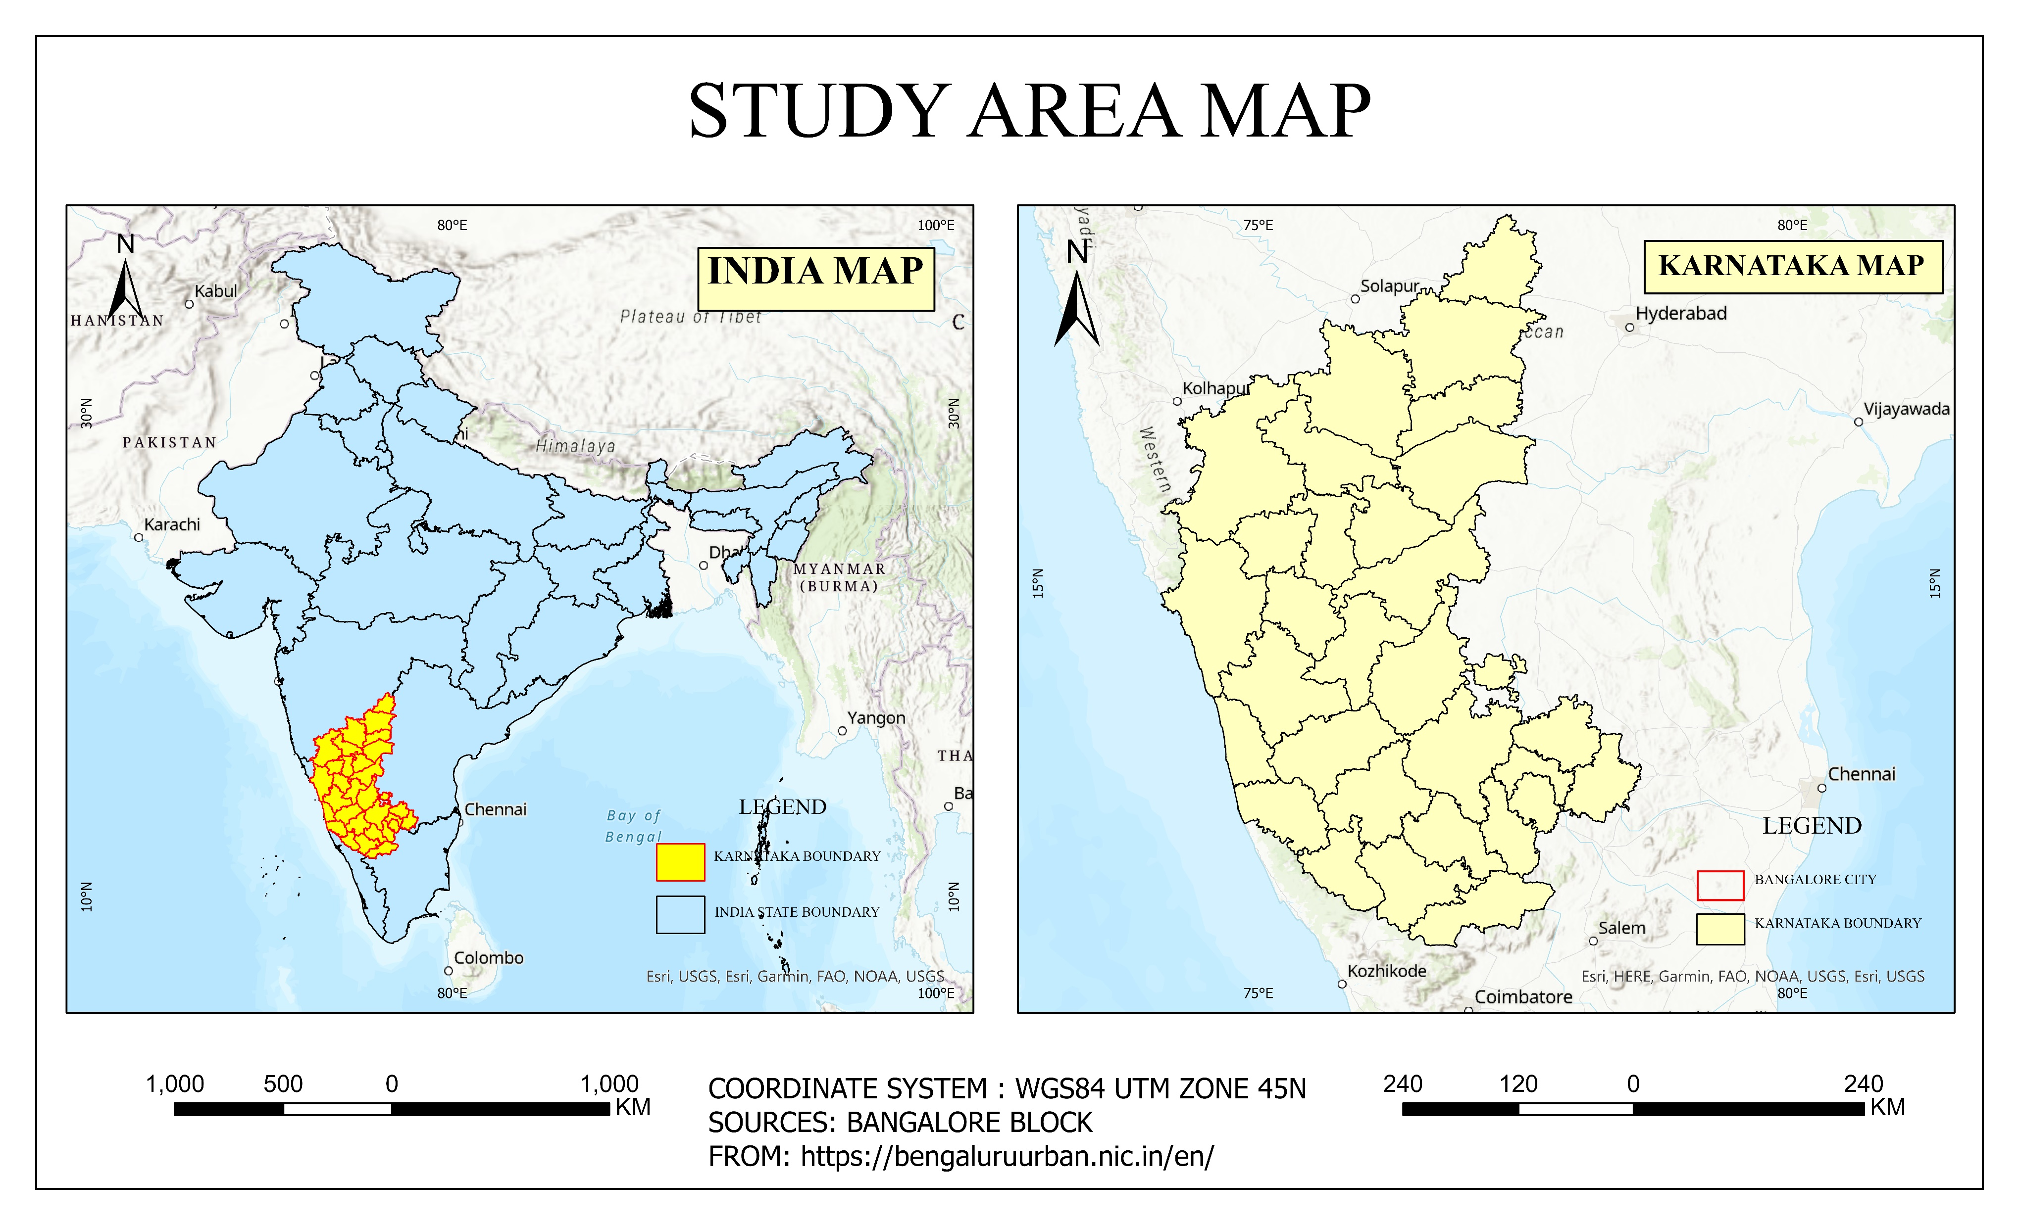

Slide 4
Objectives
Objective 1: Running Maxent model to find out impacting climatic variables for coffee arabica species occurrence and its possible distribution with all bioclim variables as impacting factor for projected year 2021-2040.
Objective 2: Projecting change in predictor variable i.e., annual temperature for year 2060-2080.
Objective 3: Generalized Linear Modelling for Karnataka region, predicting coffee arabica species distribution in state from high contributing bioclim variables.
Objective 4: Time-series analysis of predictor variables (Tmin, Precipitation) to comprehend trends for short-term climate forecast of the study area and ecologically relevant areas to species in the current scenario.

Slide 5
Methodology :Objective 1
Data
OccurenceData
Extract Bioclim Layers
Process Extent and Resolution
Worldclim Climatic Data
Convert to ASCII
Prepare Bias Layer
Convert to CSV
Create Minimum Bounding Polygon
Change Projection
Run Maxent
Run Maxent

Slide 6
Methodology :Objective 2
Libraries
Stars, sf, ggplot2 and patchwork
Get Data from Worldclim
read_stars function to process annual temperature data
Project data for India in Both periods
Calculate Change In temperature and Plot it

Slide 7
Methodology Objective 3
Libraries
Raster, pRoc, tmap
Read Occurrence Data and bioclim data.
Set extent and stack layers
Train GLM model
(binomial)
Plot change map

Slide 8
Methodology: Objective 4
Libraries
Pandas,matplotlib.pyplot,statmodel.tsa.api
Read csv pandas data.
Run Holt Linear Method
Trend=“add”
Fit the model
Forecast values

Slide 9
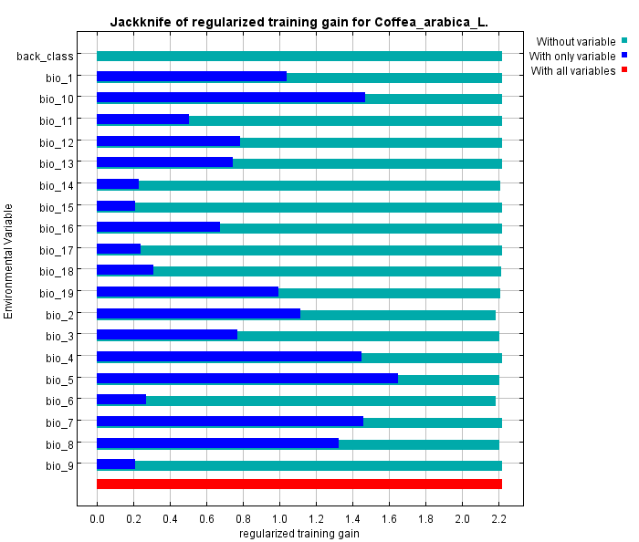
Results :Objective 1

Slide 10
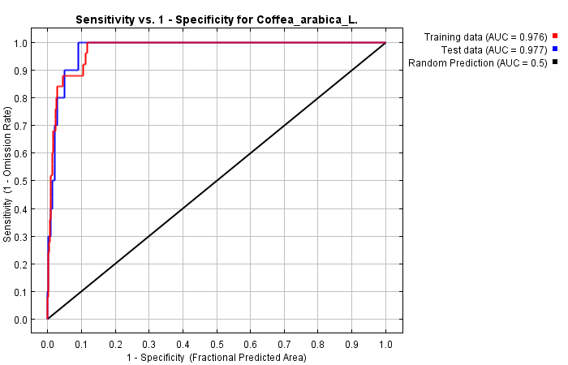
Results :Objective 1

Slide 11
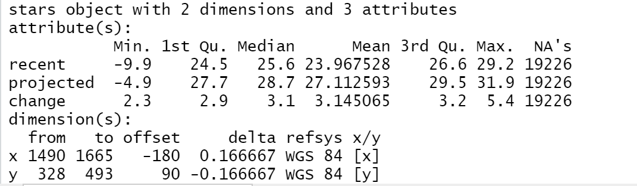
Results : Objective 2

Slide 12
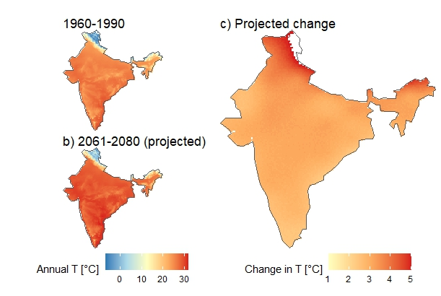
Results : Objective 2

Slide 13
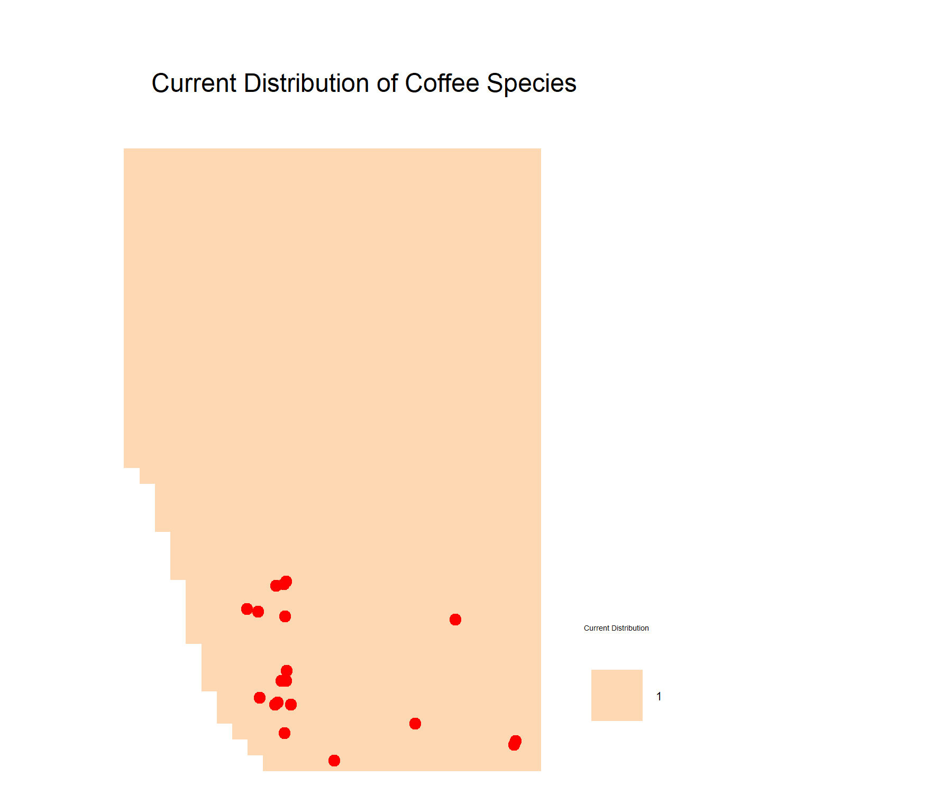
Results :Objective 3

Slide 14
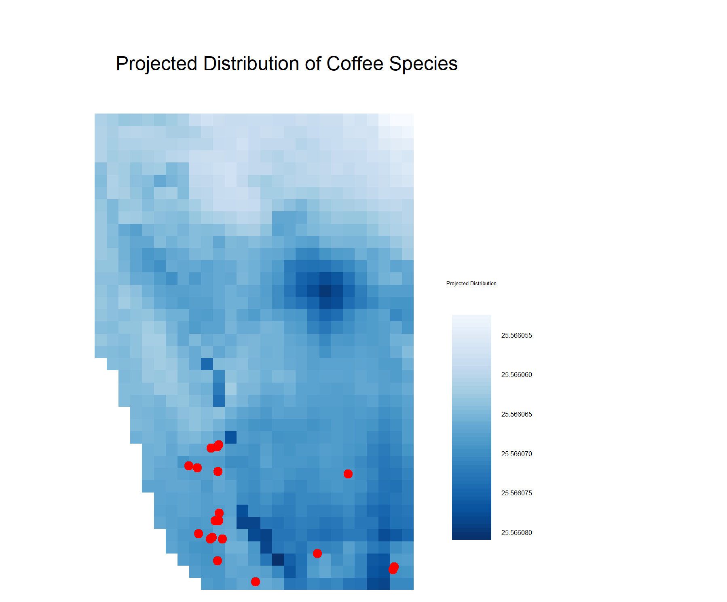
Results :Objective 3

Slide 15
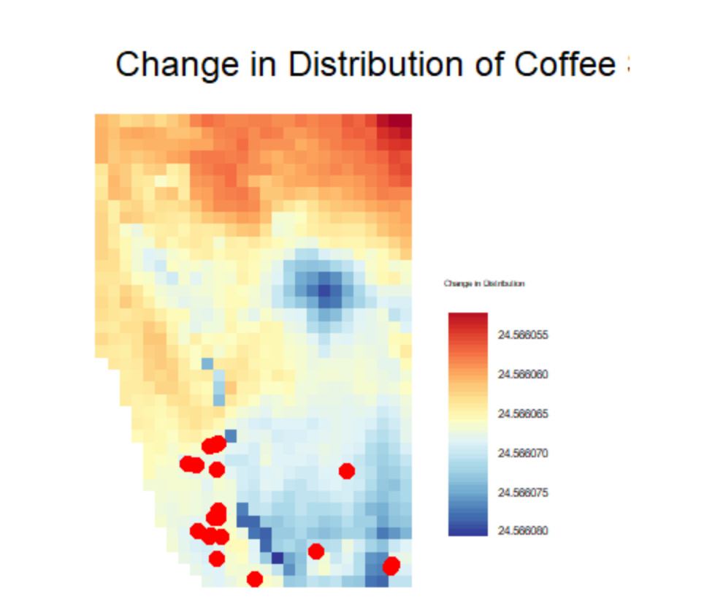
Result Objective 3

Slide 16
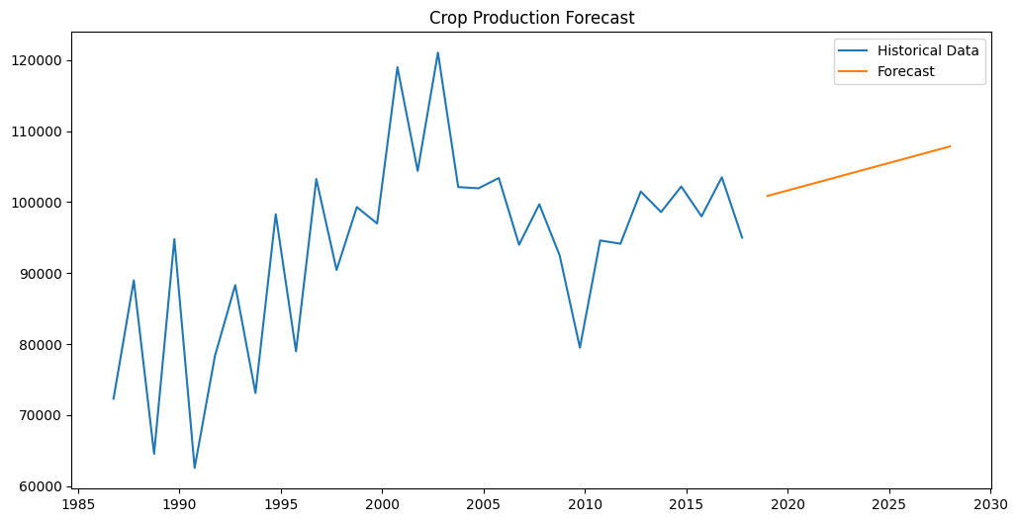
Result Objective 4

Slide 17
Result Objective 4
Year | Crop Production(M/T)
2018-10-01 2018-12-31 2019-10-01 2019-12-31 2020-10-01 2020-12-31 2021-10-01 2021-12-31 2022-10-01 2022-12-31 2023-10-01 2023-12-31 2024-10-01 2024-12-31 2025-10-01 2025-12-31 2026-10-01 2026-12-31 2027-10-01 2027-12-31 | 100872.412062 101647.288894 102422.165726 103197.042558 103971.919390 104746.796223 105521.673055 106296.549887 107071.426719 107846.303551

Slide 18
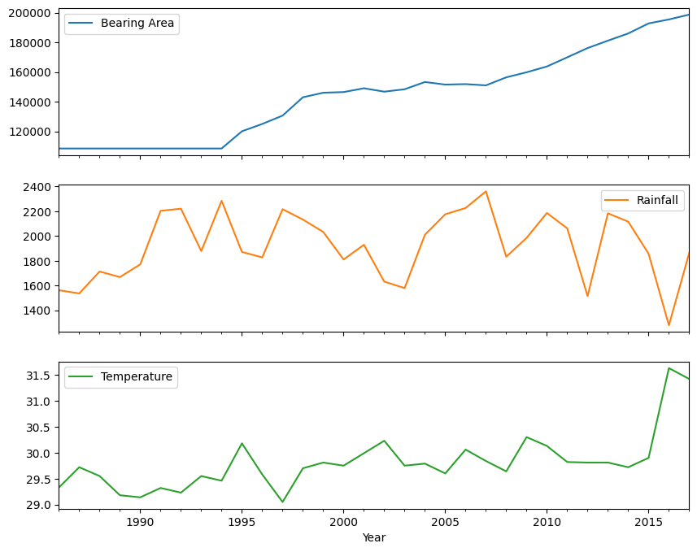
Result Objective 4

Slide 19
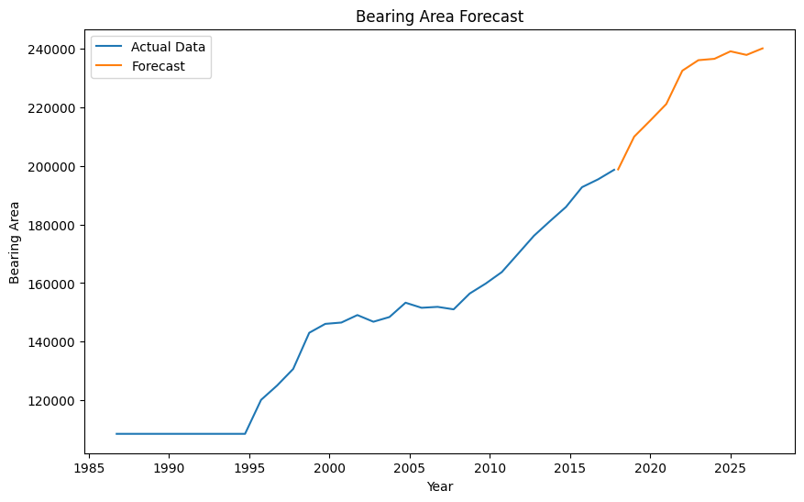
Result Objective 4

Slide 20
Result Objective 4
Year Bearing Area (Hectares)
2018-10-01 198811.155464 2019-10-01 209988.615898 2020-10-01 215476.558928 2021-10-01 221127.122355 2022-10-01 232513.706412 2023-10-01 236100.578089 2024-10-01 236567.375361 2025-10-01 239128.128220 2026-10-01 237900.591556 2027-10-01 240129.439221

Slide 21
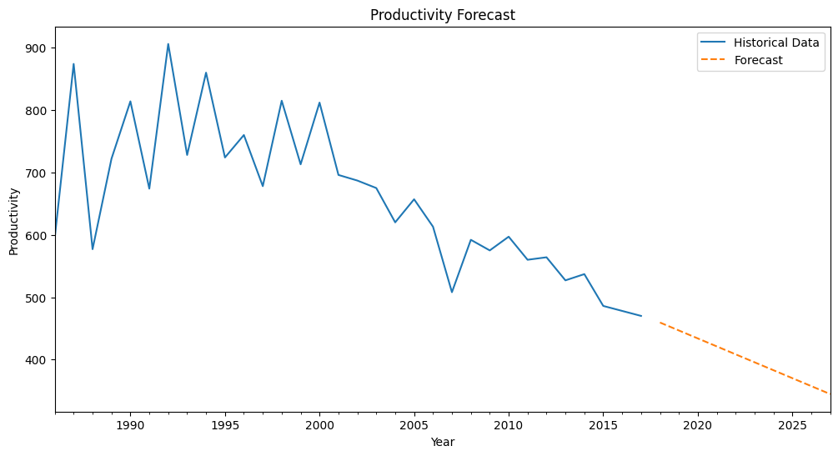
Result Objective 4

Slide 22
CONCLUSION
In conclusion, this study highlights the significance of temperature as a crucial bioclimatic variable that greatly influences Coffee arabica production in India. The impressive AUC curve value of 0.976 further confirms the model's excellence in classification.
The projected data for the years 2060-2080 paints a clear picture of an inevitable 3-degree Celsius temperature rise in India. This information is essential for understanding the potential future impact on coffee arabica production.
Moreover, utilizing GLM modelling on the current species occurrence locations, it is suggested that under the influence of four major bioclimatic variables, the occurrence of the species is highly likely to deviate by approximately 40 kilometres from its current location by 2060-2080.
This emphasizes the need to consider the potential geographical shifts that may occur in response to changing bioclimatic conditions.
Looking towards the short-term forecast, the Holt linear timeseries analysis indicates that over the next decade, the production and bearing area of coffee arabica are expected to increase. However, it is crucial to note that despite this growth, the concerning trends observed in temperature and precipitation patterns in India will undoubtedly lead to a drastic decrease in productivity (measured in kilograms per hectare).

